Slide 1
SAP CAP in Flight: BTP Cloud Foundry Automated Deployments with Azure DevOps
John Patterson
BTP Cloud Sherpa
Month 09, 2023

Slide 2
Goals of the Session
Understand why creating CI/CD pipelines for SAP CAP developments, is important and beneficial
Learn how Azure DevOps can help you on your CI/CD journey
See examples of a simple pipeline and an advanced pipeline
Get access to the resources to try them yourself
** Everything I show is available with the free versions

Slide 3
Agenda
Introduction ( 5 min )
Problems and benefits of CI/CD ( 5 min )
What is Azure DevOps ( 10 min )
Examples of pipelines ( 20 min )
Conclusion ( 5 min )
Notes:
Remove times

Slide 4
Introduction
Who is John Patterson BTP Sherpa?
What are CI/CD pipelines?
Why Azure DevOps pipelines?

Slide 5
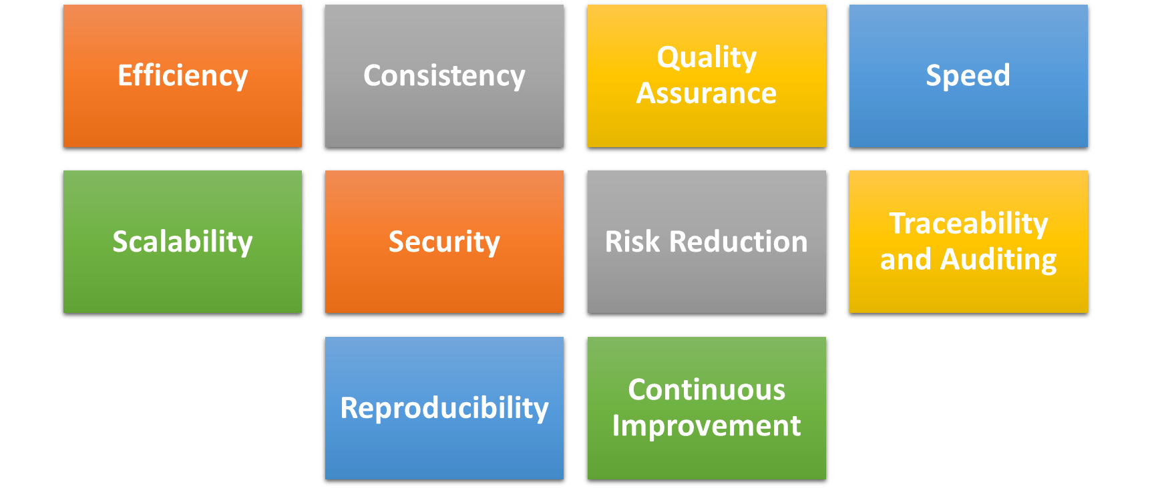
Problems and benefits of CI/CD
Notes:
Efficiency: CI/CD streamlines development, reducing wasted time and effort.
Consistency: Ensures uniformity in software builds and deployments.
Quality Assurance: Automated testing enhances software reliability.
Speed: Accelerates development cycles for faster time-to-market.
Scalability: Easily handles increased workloads as your project grows.
Security: Integrates security measures to protect your code.
Risk Reduction: Identifies and mitigates issues early in the process.
Traceability and Auditing: Provides a clear history of changes for compliance.
Reproducibility: Allows easy recreation of any past build or release.
Continuous Improvement: Encourages ongoing enhancements and optimizations.

Slide 6
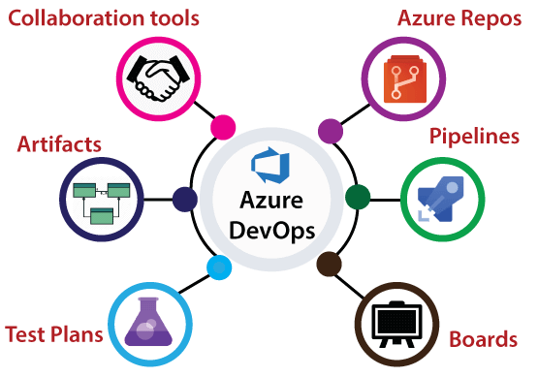
What is Azure DevOps?
Notes:
Artifacts: Package management tool for hosting and managing own packages, including npm and maven, docker etc.
Test Plans: Test management tool for planning, tracking, and managing testing efforts
Boards: Agile project management tool for planning, tracking, and discussing work across teams.
Pipelines: Continuous Integration/Continuous Deployment (CI/CD) platform for automating software delivery pipelines.
Azure Repos: Version control system, including Git repositories for source code management.

Slide 7
Demo
Quick overview of Azure DevOps
Notes:
Note my version of azure devops Is the free version, with paid version you get a lot more features like parallelization and faster agents

Slide 8
Azure DevOps Demo
Summary, what we saw
How to create a repo in Azure Repos
How to setup up a build pipeline for the repo
How the yaml was structured
How we incorporate available task
How we could search for available extensions in marketplace
How the pipeline was triggered on commit
How to see the results of the pipeline run

Slide 9
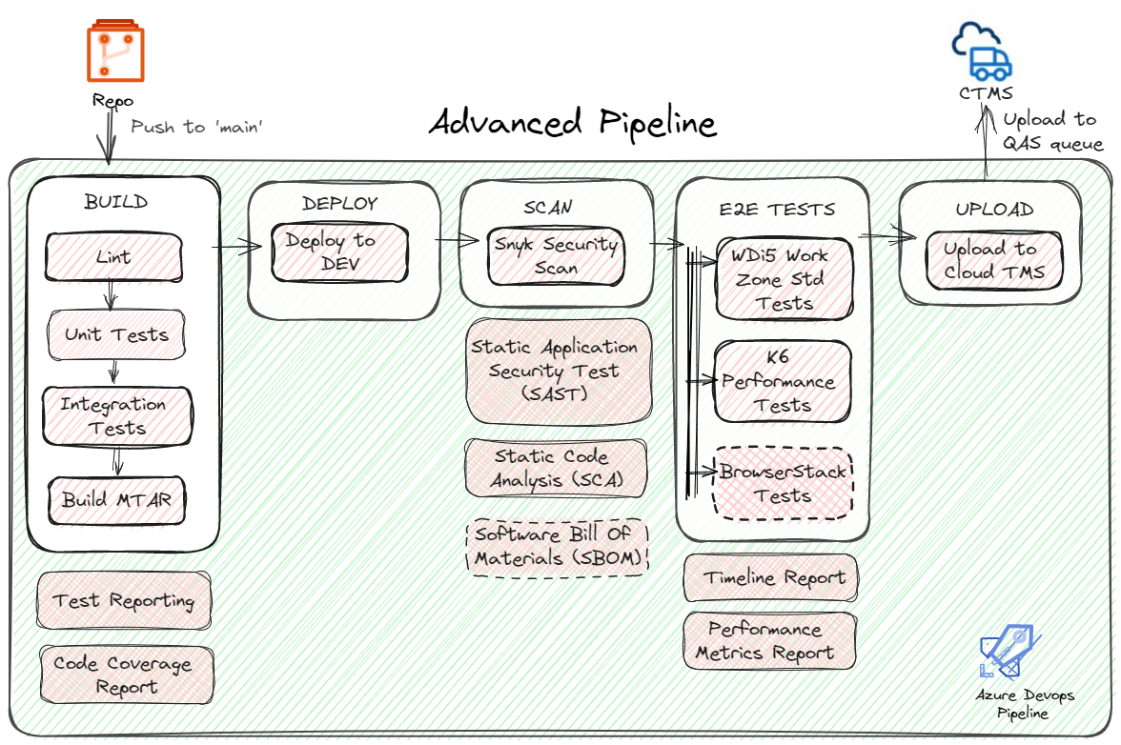
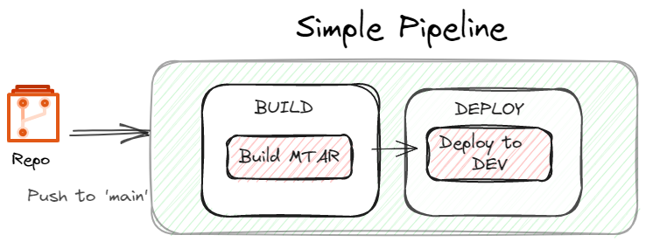
Examples of pipelines
bit.ly/DevtoberCAP
Notes:
Introduces cap-flight-devops repo
Show running in BTP build workzone standard

Slide 10
Demo
Simple and Advanced pipelines

Slide 11
Conclusion: We Covered
How CI/CD Improves SAP CAP with Faster Feedback, Quality, Risk, and Collaboration.
How Azure DevOps Helps with Code Management, Building, Testing, and Deployment.
How to Create Templates for Reusable and Scalable Pipelines.
Link to Git Repo bit.ly/DevtoberCAP for You to Try and Learn More.

Slide 12
Thank you
Contact information:
John Patterson
SAP BTP Cloud Sherpa
https://www.linkedin.com/in/johnspatterson/
https://twitter.com/jasper_07

Slide 13
Agenda
Main topic: 72, size 28pt
72, size 20pt for second level
72, size 16pt for third level
Main topic: 72, size 28pt
72, size 20pt for second level
72, size 16pt for third level

Slide 14
Text with two column text without bullet points
Main topic: 72, size 28pt
72, size 20pt for second level
72, size 16pt for third level
Main topic: 72, size 28pt
72, size 20pt for second level
72, size 16pt for third level

Slide 15
Title only layout

Slide 16
Small title only layout

Slide 17
Title square photo layout
Smaller text

Slide 18
Square photo layout

Slide 19
Demo
Speaker name

Slide 20
Demo
Speaker name

Slide 21
Demo
Speaker name

Slide 22
Section title

Slide 23
Section title

Slide 24
Section title

